Slide 1
Batch-86
Presentation On Baby Zone E-cart Application
Team-04
Presented By: Kaviyapriya
Manavi
Pavitra
Pragna
Sujana

Slide 2
Contents
Problem Statement
Design
Technologies Used
Results

Slide 3
Problem Statement
Babies and kids grow – fast. And the retailers tapping in to serve parents in need of toys, clothing, and gear are growing equally as quickly.
BabyZone is an E-commerce application where several users can use the application to buy the baby essentials along with multiple payment options and delivery services.

Slide 4
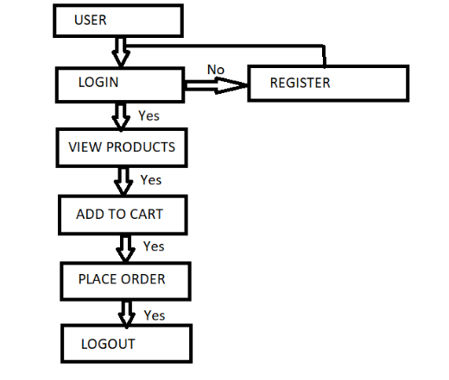
Design
Work Flow Diagram :

Slide 5
Technologies Used
React js
Spring boot
Sql

Slide 6
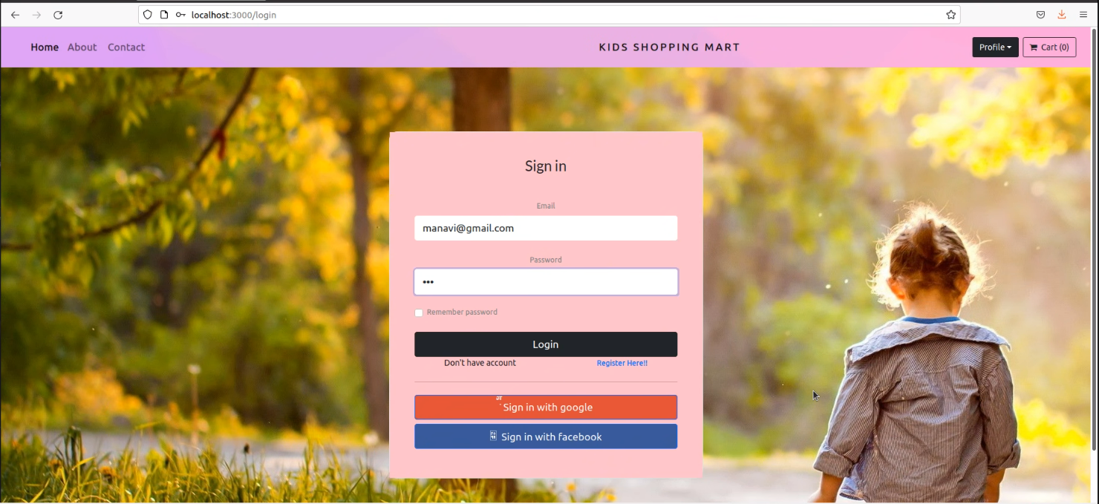
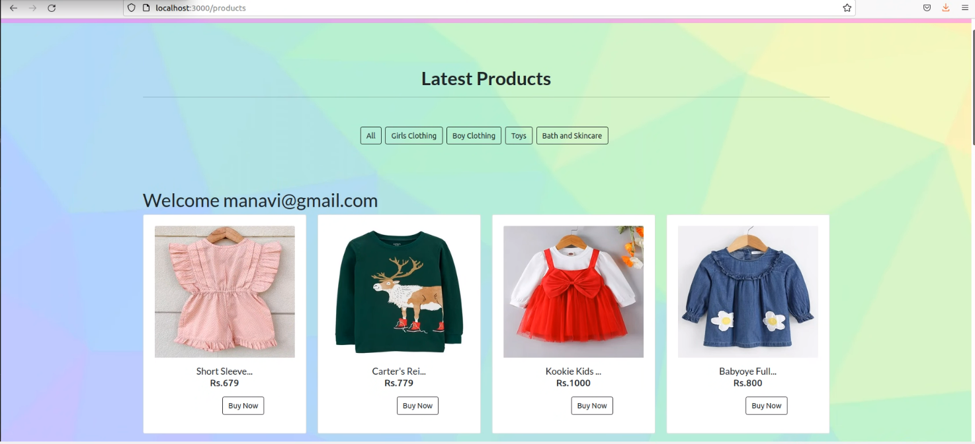
Results

Slide 7
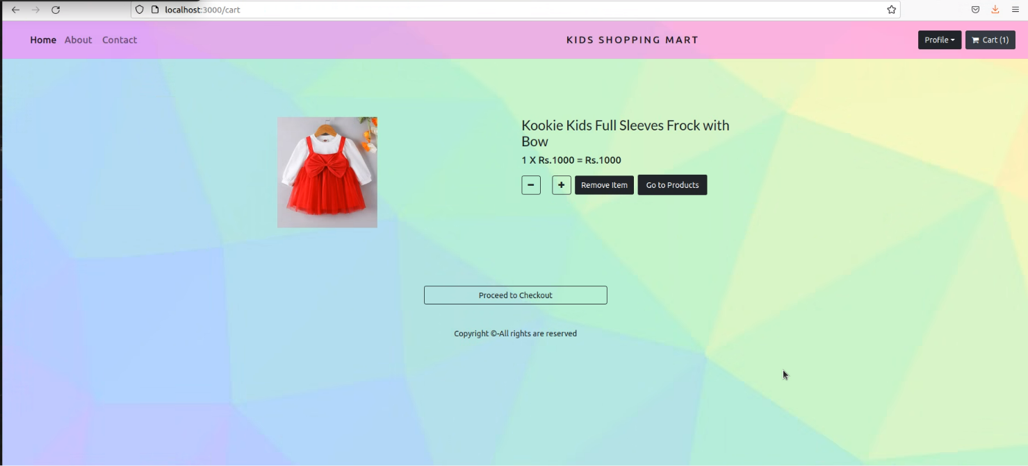
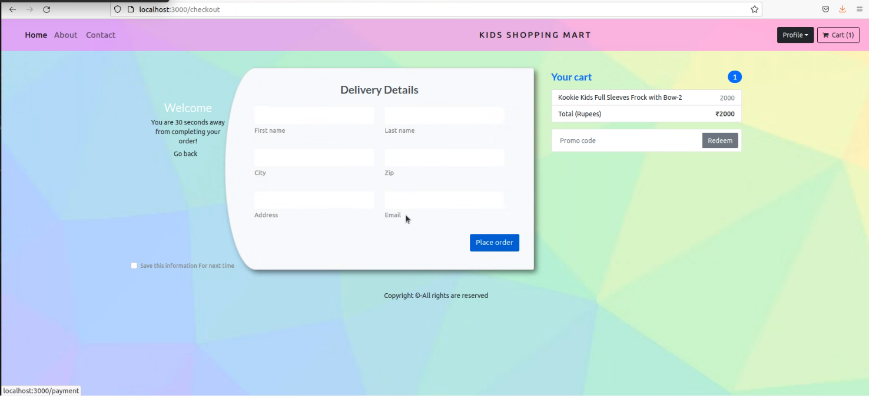

Slide 8
THANK YOU

